Slide 1
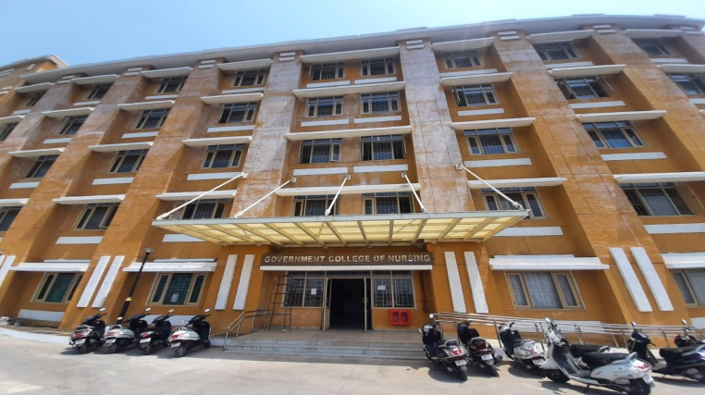
GOVERNMENT COLLEGE OF NURSING
G.M.C BHOPAL

Slide 2
Introduction
The government college of nursing Bhopal school of nursing was established in 1940. and the college of nursing was started in 2018 Bhopal .which is situated in the beautiful city of lakes of Madhya Pradesh From the beginning the G.N.M. (diploma) course started in school of nursing .The B.sc nursing programme started in 2018 and M.sc nursing programme also started in 2021 in our college .The very talented and more knowledgeable teachers teach us under there guidance and supervision .All the programme are run smoothly and perfectly .This college also have the hostel facility of student for their living .We have hospital at backside of the college and have the higher authorities to give us proper guidance to regulate the college.

Slide 3
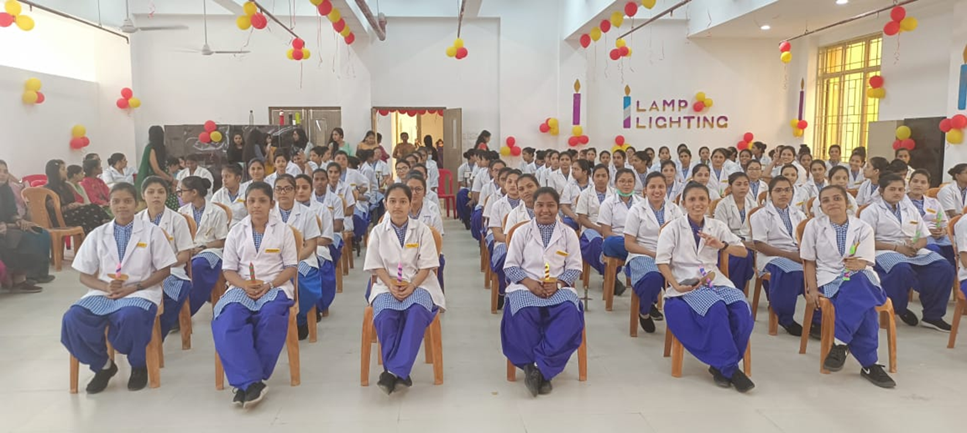
CURRICULUM ACTIVITIES IN OUR COLLEGE

Slide 4
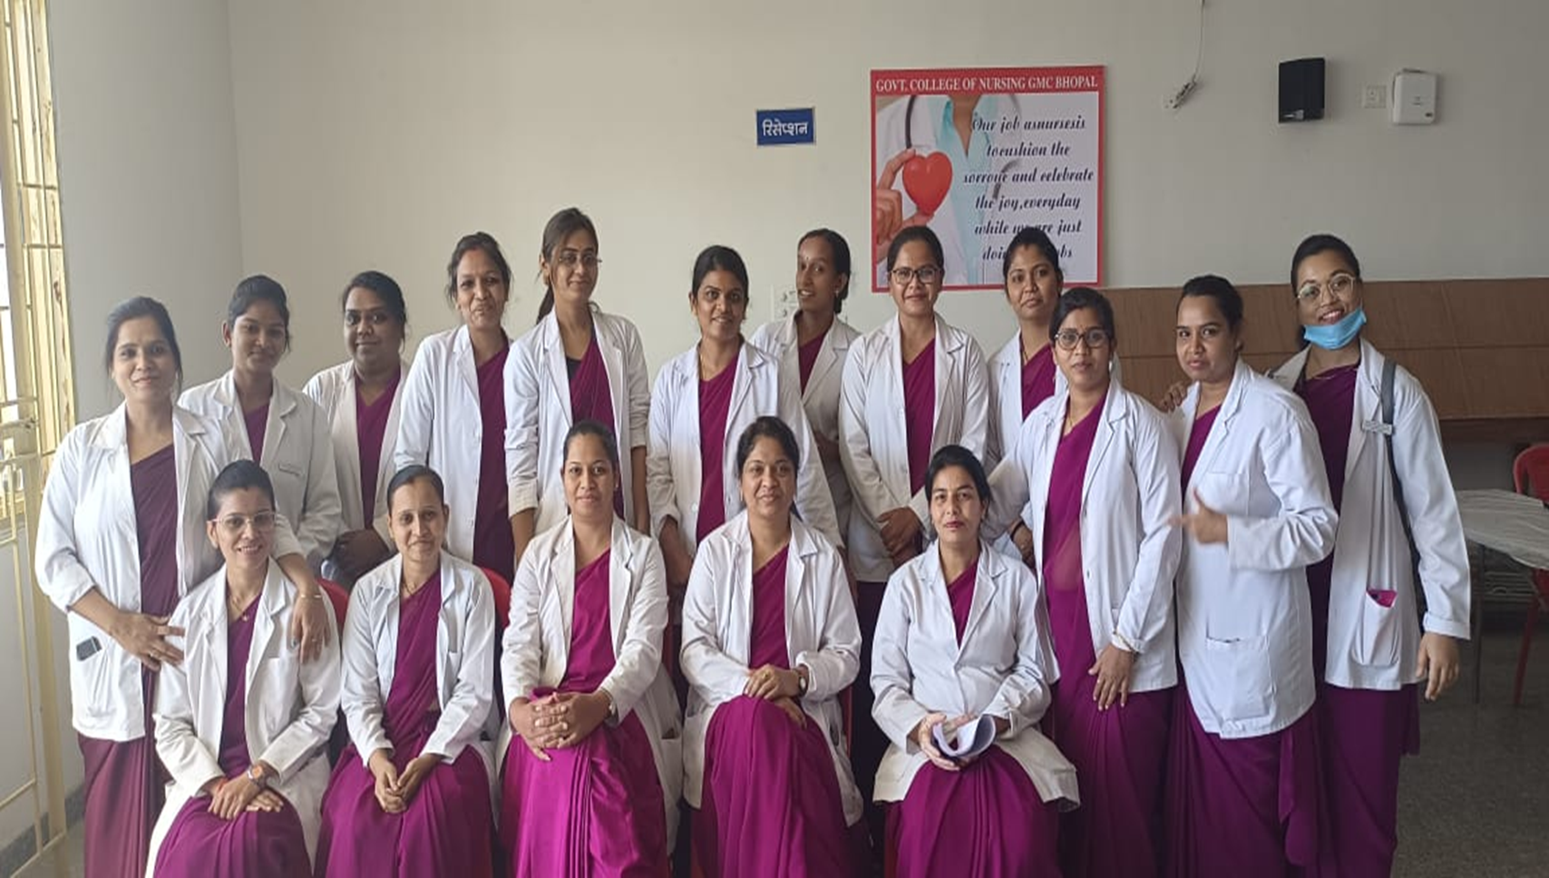
M.SC.NURSING STUDENTS

Slide 5
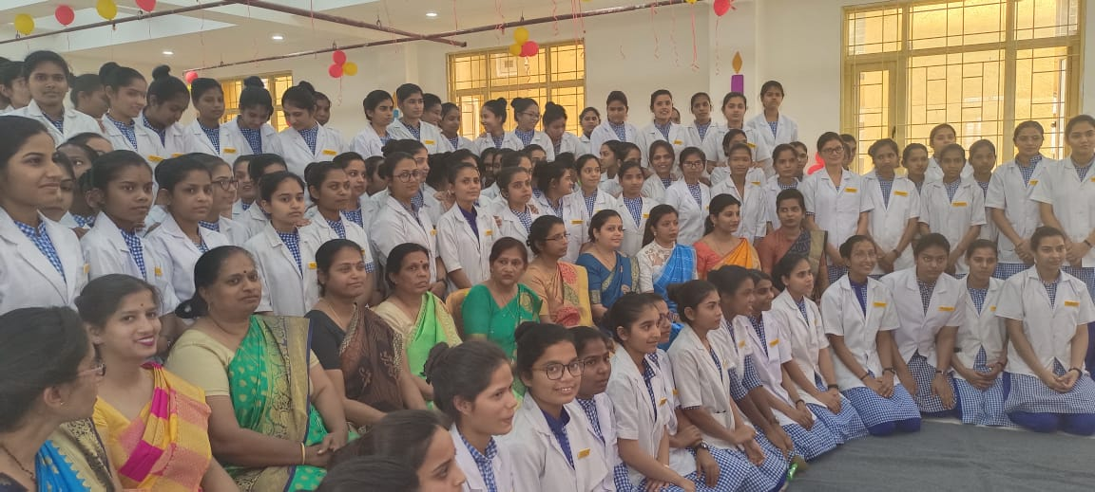

Slide 6
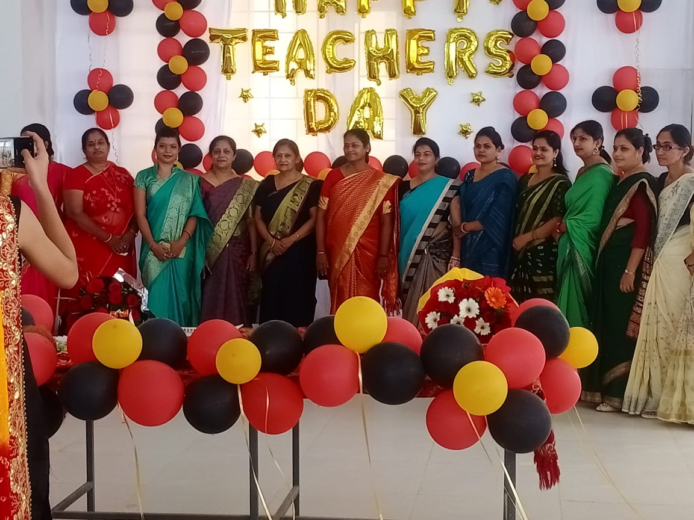

Slide 7
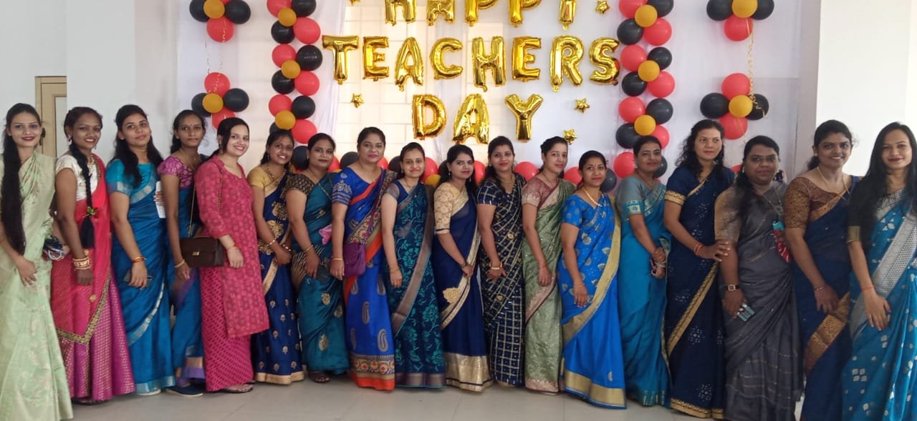

Slide 8
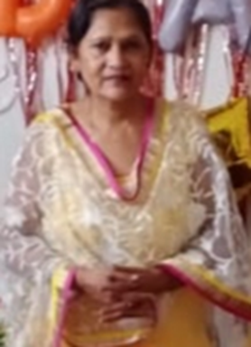
CURRICULUM VITAE
Mrs. Rosy Suhel
Principal Govt. college of nursing
Educational Qualification
B.sc Nursing was completed in 1981 from Govt college of Nursing.
M.sc. Nursing from CHRI Gwalior in 2006
Phd. from Peoples University Bhopal
Working
And acting as a principal in govt college of nursing from 2009 .

Slide 9
PRE TEST

Slide 10
THEME OF THE SESSION
Health is determined by behaviour in many ways .’A healthy life-style can be promoted by various means ranging from educational and counselling programmes to provide financial incentives for a healthy life –style .Requiring the elderly to radically change their diet and start exercising was perceived as disturbing to their peace and wellness .
Themes discussed between the older adults and professional differ according to the needs and wishes of the particular ,but often encompass diet ,alcohol ,smoking ,exercise ,sleep ,stress ,unintentional loneliness and quality of life based on assessment of needs ,strategies are discussed often locally available activities /services that may help overcome unmet needs .Health care professional and older adults that shapes the participation in health promotion services .

Slide 11
Most of older adults reports good mental health and have fewer mental health problems than other age –groups. Older adults experience a mental health problems such as depression ,Alzheimer's disease ,anxiety ,panic disorders and dementia .Neurological findings is common in old age common symptoms in the elderly includes cognitive difficulties ,balance and gait disorders ,tremors and neuropathy .
Geriatric rehabilitation : Geriatric rehabilitation programmes for older adults:
Rest and protect from injury .Recover your motion ,strength ,functions.
Right treatment for you .
Rehabilitation therapy are occupational ,physical ,speech therapy ,special exercise and improve mobility and regain strength .

Slide 12
Evidence based programmes can educate ageing people to promote good health and reducing disease, disability and build skills to take control of their health from lowering the risk of falls to better managing chronic condition ,engaging in physical activity and managing mental health and improved quality of life.

Slide 13
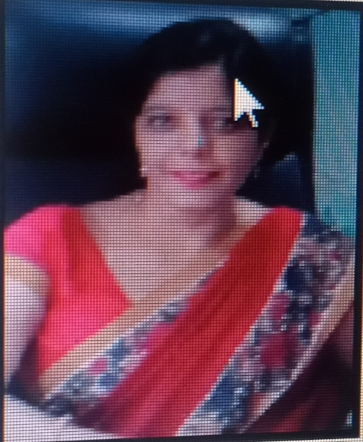
CURRICULUM VITAE
PROF. DR. JYOTI M. NIRAPURE
PROFESSOR AND PRINCIPAL (NAAC Accredited)
COMMUNITY HEALTH NURSING
SUMMARY: -
I have done PhD from Himalayan University Itanagar, completed my masters in Community Health Nursing from Gwalior College of Nursing, affiliated to Jiwaji University Gwalior in the year 2007; and completed my bachelor degree from Government College of Nursing, Devi Ahilya University Indore, in 2001.
OBJECTIVES:-
Aspiring for the challenging career in Nursing Profession, desirous of taking up challenging jobs and executing them in time and to the satisfaction of the client, given with a prospective growth in career.

Slide 14
ACADEMIC CREDENTIALS:
Ph. D. Nursing - Himalayan University Itanagar in year 2019. M. Sc. Nursing - Secured 81% from Jiwaji University Gwalior in year 2009. B. Sc. Nursing - Secured 68.4% from Government College of Nursing in 2001. School - Secured 67% from M.P Board of Secondary Education.
WORK EXPERIENCE:
Working as a Principal in NRI Institute of Nursing, Bhopal from 1 April 2019.
Worked as a Vice Principal in Peoples College of Nursing and Research Centre, Bhopal from 13 March, 2012 to 30TH March 2019.
Worked as a Principal in Sunder Devi Nursing of College, Bhopal from 01/03/2014 to 12/01/2016
Worked as a Principal in Batra College of Nursing, Bhopal from 01/07/2009 to 28/02/2012.

Slide 15
PAPER PRESENTATIONS:
Presented a paper on “A study to assess the effectiveness of self instructional module on knowledge regarding teenage pregnancy among female students of selected colleges of People’s group Bhopal (M.P.)” at Madhya Pradesh Young Scientist Congress, Bhopal (M.P.) on 10th march 2017.
Presented paper on “A study to assess the preferred choice of contraceptive method among married women residing in urban and rural area of Bhopal city” at Maulana Azad National Urdu University, Hyderabad, India form 19-20 September 2016.
Presented paper on “Biological warfare” at management workshop organized by People’s College of Nursing & Research centre from 30th march 2011.

Slide 16
WORKSHOPS, CONFERENCES AND SEMINARS ATTENDED:
Attended Training of trainers for Virtual class room organized by JHPIEGO from 06/08/2017.
Attended Dakshata Training organized by JHPIEGO from 11-13/04/2017.
Attended National Workshop on “Systematic Review & Meta – Analysis” organized by AIIMS, Bhopal on 27th -28th February, 2017.
Attended National Conference on Gender Equality Women Empowerment organized by Maulana Azad National Urdu University, Hyderabad on 19/ 09/ 2016.
Attended International Conference on Research Methodology organized by Omayal Achi College of Nursing, Chennai, India on 28-30 January 2016.
Attended scientific writing workshop organized by CSRD (Centre for Scientific Research and Development) People’s University on 26-27 November 2015.
Participated in 15th M.P state deacon- 2015 on 19TH & 20T September 2015.
Attended in the state SOMCON conference on “ Promoting Natural Child Birth “ conducted AT Chirayu College of

Slide 17
Attended trainers of trainee programme for tuberculosis under GFATM conducted from 24-26 November 2014.
Participated in nursing research conference on “Enhancing quality patient care through clinical Nursing Research” organized by global research Nurses network, University of Oxford, U.K and Pragyan college of nursing, Bhopal on 11th November 2014.
National conference on TELEMEDICONE 14 organized by AIIMS Bhopal on 7th -9th November 2014.
Participated in the seminar on “clinical research Emerging Carrie avenues “organized by QREC clinical research on 29th march 2014.
National Conference attended on research design on 29th April 2013.
Attended the national workshop on research methodology by AIIMS, Bhopal on 17th to 21st December 2020.
Attended the national workshop on research methodology by on 15th-16th April 2020.
Attended a seminar on ageing and health at People’s College of nursing and research center on April 2012.
Composed regional center for person with disabilities – Bhopal on introduction to rehabilitation nursing on 1st to 2nd Feb. 2010.
Second national conference – 2012 on exploring new avenues in nursing research methodology 14th and 15th Feb. 2012.
Participate in nursing NEOCONE 11 state conference cum workshop on new bond care at Choithram College of nursing Indore (M.P.) on 5th and 6th march 2011.

Slide 18
Critical care nursing workshop hold during the 14th annual conference conducted by the Indian society of critical care medicine at Bhopal between 30th to 17th Feb. 2008.
Attended the workshop on educational technology conducted by college of nursing Indore from 22nd march to 29th march 2004.
Attended the workshop on educational technology conducted by college of nursing Indore FROM 5TH April to 12th April 2003.
Attended the workshop on management technique conducted by college of nursing Indore from 5th April to 12th April 2003.
Participated in the conference are “qualitative research method” organized by international center for collaborative research in primary health care, Omayal Achi college of nursing on 11th and 12th Jan. 2010
Participated in the 6th international neonatal nursing conference on 18th September 2007 new Delhi.
Participated on 6th international neonatal nursing conference on 15th to 18th September 2007 new Delhi.
5th international conference on trauma and critical care organized by dept. of orthopedics and Traumatology , MGM medical college and MY hospital Indore on 16th -17th march 2002.

Slide 19
RESEARCH AWARD:
Awarded young researcher fellowship training award by M.P Young Scientist Congress march 10th 2017
Best research under mission TRP 1000 for “Retrospective Clinic Diagnostic Evaluation of causes of Primary and Secondary Infertility among Infertile Women visited peoples Hospital Bhopal India”

Slide 20
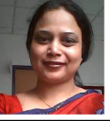
CURRICULUM VITAE
MRS MAMTA VERMA
ASSOCIATE PROFESSOR, PROF CUM PRINCIPAL IN CHARGE
COLLEGE OF NURSING, ALL INDIA INSTITUTE OF MEDICAL
SCIENCES ,SAKET NAGAR BHOPAL
Master of nursing (Pediatric nursing )2005 from Rajkumari Amrit Kaur college of
nursing ,Delhi university
• M.A. Sociology from Barkatullah University, Bhopal, MP, India
• Postgraduate diploma in management of reproductive and child health programme& one-
year distance learning course From Indian Institute of Public Health (IIPH), New Delhi,
2015
• Certificate in research methodology, 06-months course from Indian Institute of Public
Health (IIPH), Gandhi Nagar, 2012
• Three month online course on global public health offered by SDSN through March to
May 2015
• PhD scholar (public health), enrolled on 2015 from Tata Institute of social sciences,
school of Public Health, Mumbai

Slide 21
Achievements: Citation 80,h index 3 and i10 index 3
(i) Research publications
1 . Garg R, Singh G, Kumar S, Verma M, L, Ingle VA, Karuna T, Saigal S,Walia K, Khadanga S. Impact of an Anti-Microbial Stewardship Program on Targeted
Antimicrobial Therapy in a Tertiary Care Health Care Institute in Central India. Cureus. 2021
Oct 5;13(10):e18517. doi: 10.7759/cureus.18517. PMID: 34754675; PMCID: PMC8568562.
2. Alkesh Khurana, Aqeel Hussain, Raj Krishnan Soman, Abhishek Goyal, Brijendra Singh Impact of six-week hospital based Pulmonary Rehabilitation programme in patients with
post Pulmonary Tuberculosis sequelae: Initial results from a hospital based longitudinalstudy.European Respiratory Journal Sep 2020, 56 (suppl
64) 834; DOI: 10.1183/13993003.congress-2020.834
3. Patel U, Gedam DS, Verma M. Effect of back Massage on Lactation among Postnatal
Mothers. Int J Med Res Rev 2013; 1(1):05-11.doi: 10.17511/ijmrr.2013.i01.02.

Slide 22
Research projects
A. Chief Investigator
1. Role of nurses in maternal and newborn care at community health centers of rural and tribal districts of Madhya Pradesh. My PhD. Thesis project.
2. An expedition of the clinical learning experience of B.Sc. H nursing students of AIIMSBhopal:A mix-methodology.B.Co-Investigator
1. Prevalence of musculoskeletal pain conditions and their associated factors among nursing
students of AIIMS Bhopal.
2. The actual and preferred clinical learning experience and impending factors for effective
learning among nursing students
3. Anxiety, sleep, quality and coping strategies adopted among the frontline COVID warriors
during the 2nd wave of the COVID pandemic.
4. Diabetes Education and insulin knowledge assessment in Nursing staff in a recently started
tertiary care teaching hospital in India
5 Project title: Implementation of Anti Microbial Stewardship Program (AMSP) at
AIIMS Bhopal Project ID EL008

Slide 23
Awards/Scholarships/Officials Appreciation
Awards
• Secured second rank in the master of nursing 2005 RAK CON,Delhi University.
• Pratibha samman certificate to secure distinction in B.Sc. Nursing course 1999.
• Appreciation letter from Director &CEO AIIMS Bhopal
• Appreciation letter from Principal nursing college AIIMS Bhopal
• Member of the editorial board of American Journal of nursing research AJNR science and educational publishing, New York, United States.
• Member of the editorial board of Public Health Review: International Journal of Public
Health Research
• Reviewer of Sage open nursing a PubMed Index journal

Slide 24
Affiliation with the professional bodies/institutions/societies
• Vice president, telemedicine society of India, Madhya Pradesh Chapter.
• Executive member of faculty association of AIIMS Bhopal 2017-2020.
• Executive member of Indian association of neonatal nurses
• Member of trained nurses association of India, Indian association of Public health,
breastfeeding network of India, national neonatal forum and nursing research society of
India.

Slide 25
(vi)Affiliation with the professional bodies /institutions/societies
• Vice president, telemedicine society of India, Madhya Pradesh Chapter.
• Executive member of faculty association of AIIMS Bhopal 2017-2020.
• Executive member of Indian association of neonatal nurses
• Member of trained nurses association of India, Indian association of Public health,
breastfeeding network of India, national neonatal forum and nursing research society of
India.
(vii)Any research/innovative measure involving official recognition
• Implemented dual role integration of nursing education and nursing practices and volunteer
to act As In Charge Chief Nursing Officer (I/C CNO) of AIIMS Bhopal 940 bedded
hospital and approximately 1000 nursing officials deployment, training other
administrative and personnel management were taken care especially in COVID Pandemic
when AIIMS Bhopal made dedicated covid care hospital with 200 bedded COVID ICU
beds.
• Developed and implemented induction programme for newly recruited nursing officers of
AIIMS Bhopal
• Initiated nursing journal club activity for postgraduate nursing students and senior nursing
officers of AIIMS Bhopal.
• Nurses training in critical care (COVID) for M.P State nurses organized by Center of
excellence COVID care AIIMS Bhopal.
• Developed short term training programme on patient safety for nurses. It is a MOHFW
funded training scheme.

Slide 26
Professional training
• Participated in critical care nursing workshop organized by international critical care congress between 13-17th February 2008 at Bhopal
• Attended nursing CME in XX annual convention of national neonatology forum between 7th-10th October 2010 at Jaipur.
• Attended basic life support training organized by Indian academy of pediatrics at AIIMS Bhopal on 14-7.13
• Research methodology workshop (3days) organized by AIIMS Bhopal in 2013.
• Qualitative research workshop (7 days) organized by Indian Institute Of Public Health(IIPH), Gandhi Nagar, Gujrat in 2014.
• Attended two days of training on the systematic approach to Question paper setting organized by CMET AIIMS Bhopal in the year 2018.
• Training programme on implementation of NABH standards for hospitals 22.09.2017-
24.09.2017 at Bhopal.

Slide 27
organized by IANN and MMU University dated 14-16 the February 2014
• Attended NRP master trainer certificate programme on on 05.02.2021 organized byNNF,India and IANN at SGT university Gurugram Haryana.
• Pediatric oncology skills workshop organized by PODC subgroup of CCLG ,UK and pediatric hematology chapter of IAP between 17 th to 19 th February 2021
• Training of trainer on pediatric nursing emergency preparedness programme forCOVID(PNEPPCO) held on 09.09.2021 organized by AIIMS Delhi.
• Training of trainers in India for KMC(ToTKMC) on the occasion of KMCCON2022”organized by department of neonatology and pediatrics’ and KMC foundation of India at VI national conference of Kangaroo mother care in India on 7 and 8 th April 2022.
• Participated in the workshop “Role of obstetrician in promoting KMC in India” on the occasion of “KMCCON2022” organized by department of neonatology and pediatricsand KMC foundation of India at VI national conference of Kangaroo mother care in India on 9 th April 2022

Slide 28
Participated in the workshop “IMMEDIATE KMC for sick and small neonates and
MNICU(iKMC) ” on the occasion of “KMCCON2022” organized by department of
neonatology and pediatrics and KMC foundation of India at VI national conference of Kangaroo mother care in India on 9 th April 2022.
(IX) Member of the different committees of AIIMS Bhopal
(x) Any other information.
Instituted Sumer Jyoti gold medal for overall topper in BSc Hons nursing programme at AIIMS
Bhopal

Slide 29
PLENARY SESSION - 1

Slide 30
TEA BREAK

Slide 31
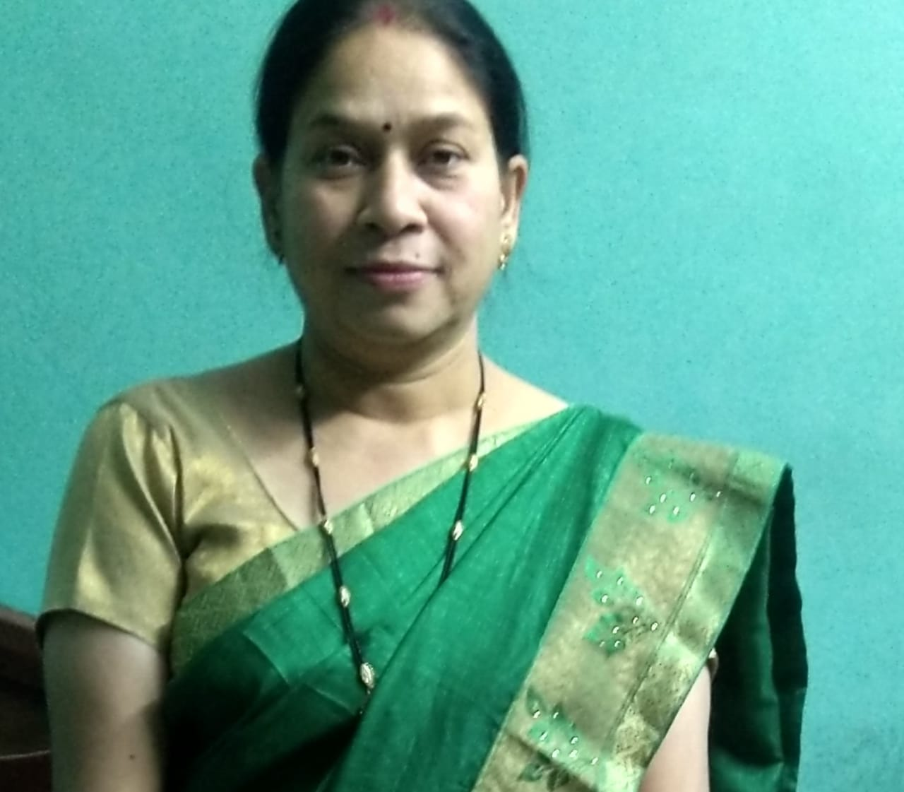
CURRICULUM VITAE
Name : Mrs. Vandana Pakhide ( Nursing Officer )
Indian Institute of Science Education and Research ,Bhopal
Qualification : 1 . BSc .Nursing from college of nursing Devi Ahilaya University, Indore M.P .1999
2. MSc . Nursing ( Medical –Surgical Nursing ) Barkatullah University Bhopal M.P.2012
3. M.A .Sociology from Dr. Hari Singh Gour University,Sagar M.P. India 2002 .

Slide 32
Experience:
More than 10 years of teaching experience in different college of nursing Bhopal. Worked as
Nursing Tutor in Bhopal Memorial Hospital and Research Centre and also as Associate
Professer in Pragyan College of Nursing Bhopal. 8.2 years of clinical experience in
Jawaherlal Nehru cancer hospital and Research centre Bhopal. Presently working as Nursing
Officer in IISER (Indian Institute of Science Education and Research) Bhopal.
Research publications
1. Pakhide, V. (2019). A descriptive study to assess the prevalence of overweight and obesity by calculating BMI (Body Mass Index) among women at selected community area of Bhopal, Madhya Pradesh, India. Public Health Review: International Journal of Public Health Research, 6(6), 214-218. https://doi.org/10.17511/ijphr.2019.i6.01
.

Slide 33
2. Pakhide V. A quasi-experimental study to assess the effect of modified
communication board on communication ability of post operative CABG patient at selected hospital Bhopal Madhya Pradesh, India. Int. J. Med Red Rev 2019;7
(6):475-481.doi:10.17511/ijmrr,2019.i06.06
3. A study to assess the effectiveness of the structured teaching program on prevention of pressure ulcer by using Braden scale among staff nurses working on selected hospital of Bhopal int J Med Res Rev 2013;1(3):120-124.

Slide 34
4. Pakhide V “A pre- experimental study to assess the effect of informational booklet on knowledge regarding prevention of oral cancer among adolescents at selected educational institute of Bhopal.” Indian Journal of Holistic Nursing.
5. Pakhide V, Verma M. Nursing Leadership Role in Pandemic. Public Health Rev Int J Public Health Res. 2021;8(2):07-12
6. Singh T, Pakhide V, Verma M. “A pre-experimental study to assess the effect of educational package on knowledge regarding haematopoietic stem cell transplantation among staff nurses working in selected hospital Bhopal, Madhya Pradesh”. Int J Med
Res Rev. 2021;9(2):58-65.

Slide 35
Verma, Mamta & Gedam S Neonatal Nursing Challenges in Covid-19 Pandemic
Nursing journal of India CXI no 6(Nov-Dec 2020):243-247
Books and manual
1. Textbook of Perioperative Nursing, 2021 by Kumar Publishing House, New Delhi
Affiliation with the professional bodies/ institutions/ societies
● Member of trained nurses association of India and NRSI (Nursing Research Society of India)
● UG level question paper setter and examiner (as external and internal) of Barkatullah University Bhopal and Madhya Pradesh Medical science University Jabalpur. PG level question paper setter and dissertation evaluator of M. Sc. Nursing students.

Slide 36
PLENARY SESSION - 2

Slide 37
LUNCH BREAK

Slide 38
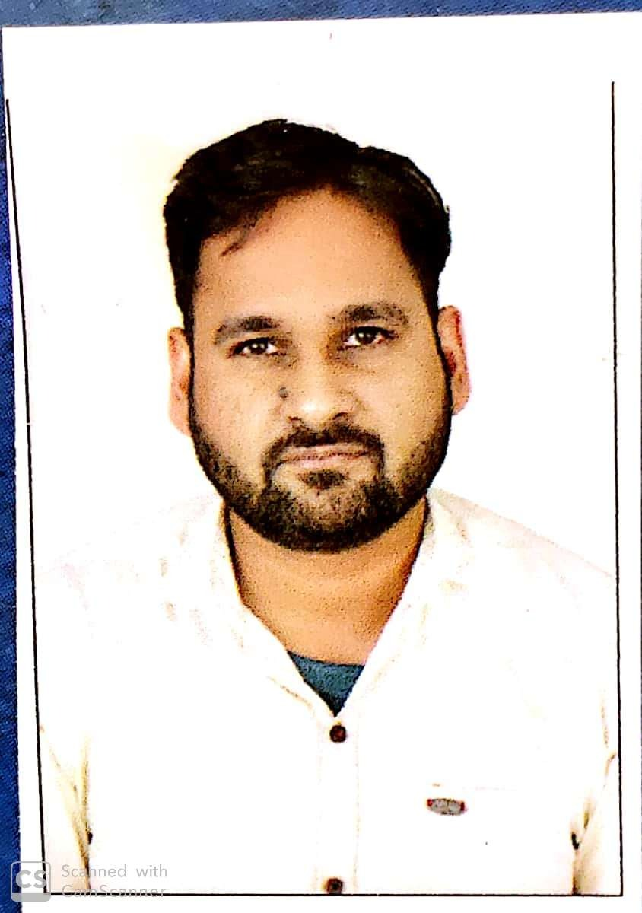
Curriculum vitae
Name - Seemant Parashar
OBJECTIVE
-To work for the development of self and organisation.
-To achieve a challenging position and utilize my skills and talents for the upgradation of the organization on par with updated standards.
PROFESSIONAL SUMMARY
1.Persuing PhD. Nursing (going to award this year)
2.M.Sc. Nursing (Specialization in Psychiatric Nursing)
3.B.Sc. Nursing
4.M.BA. in hospital administration

Slide 39
COMPUTER SKILLS
Internet, power point, Microsoft word, excel and basic operations.
ACADEMIC PROJECT
PhD Topic – A real time survey to assess the effect of social media on professional development of nursing students from selected nursing college of Bhopal
Title of the Problem: “A study to assess the knowledge of primary school teachers regarding behavioral problems and their prevention among children’s in selected primary schools in Bhopal District with a view to develop an information booklet.

Slide 40
.
S.N0. | NAME OF JOURNAL | ARTICLE PUBLISHED
1 | International Journal of Multidisciplinary Research and Development Online ISSN: 2349-4182 Print ISSN: 2349-5979, Impact Factor: RJIF 5.72 www.allsubjectjournal.com/ Volume 3; Issue 5; May 2016; Page No. 107-108 | A study to assess the effectiveness of mindfulness meditation technique on stress reduction among first year B. Sc. nursing students in SAM College of nursing, Bhopal, MP
2 | International Journal of Medical and Health Research ISSN: 2454-9142, Impact Factor: (RJIF 5.54) www.medicalsjournals.com/ Volume 2; Issue 5; May 2016; Page No. Page No. 62-63 | A descriptive study to assess the knowledge related to substance abuse among adolescents in selected Colleges of Gwalior
3 | International journal of pharmaceutical science and research volume 1, issue 3, Page. No. 46-47 | Revolution in mental health and nursing after discovery of lithium
4. | International journal of applied research volume 2, issue 5, Page No. 924-925 | “A study to assess the effectiveness of structured teaching program on knowledge regarding first aid for burns and it’s prevention in under five children among B. Sc. nursing second year students of SAM College of nursing, Bhopal.”

Slide 41
ACHIEVEMENTS
Inspector from M.P. Medical Science university Jabalpur
External examiner and center superintendent for GNM Exams from M.P. Nursing council
External examiner for viva and practical exam from M.P. medical science university Jabalpur (M.P.)
Examiner paper setter from various universities and in skill India programme govt. of India
Worked as a program officer in NSS
Participation in social welfare activities
CONFERENCES ORGANIZED AND ATTENDED as deligate in State level seminar on Legal and Ethical issues in Nursing:”A key to safe practice & quality patient care”held on 22nd April,2016,at Kasturba College Of Nursing ,Bhopal, MP.
Conference on :Enhancing Quality Patient Care through Clinical Nursing Research”
, Nov, 11, 2014 at Pragyan College of Nursing,Bhopal,Organised by oxford university.
Attended as deligate in National Level Conference On Research Design on 20th, april, 2013 at Peoples University. Bhopal.
National conference on” Emerging Methodology in Nursing Research” on 3rd ,may,2016nat pragyan college of Nursing,Bhopal
HOSPITAL AND COMMUNITY CENTRE INVOLVED IN TRAINING:
Jaya Arogya Hospital,Gwalior,India
Kamla Nehru Hospital,Gwalior,India
Manasik Arogya shala Gwalior

Slide 42
PLENARY SESSION -3

Slide 43
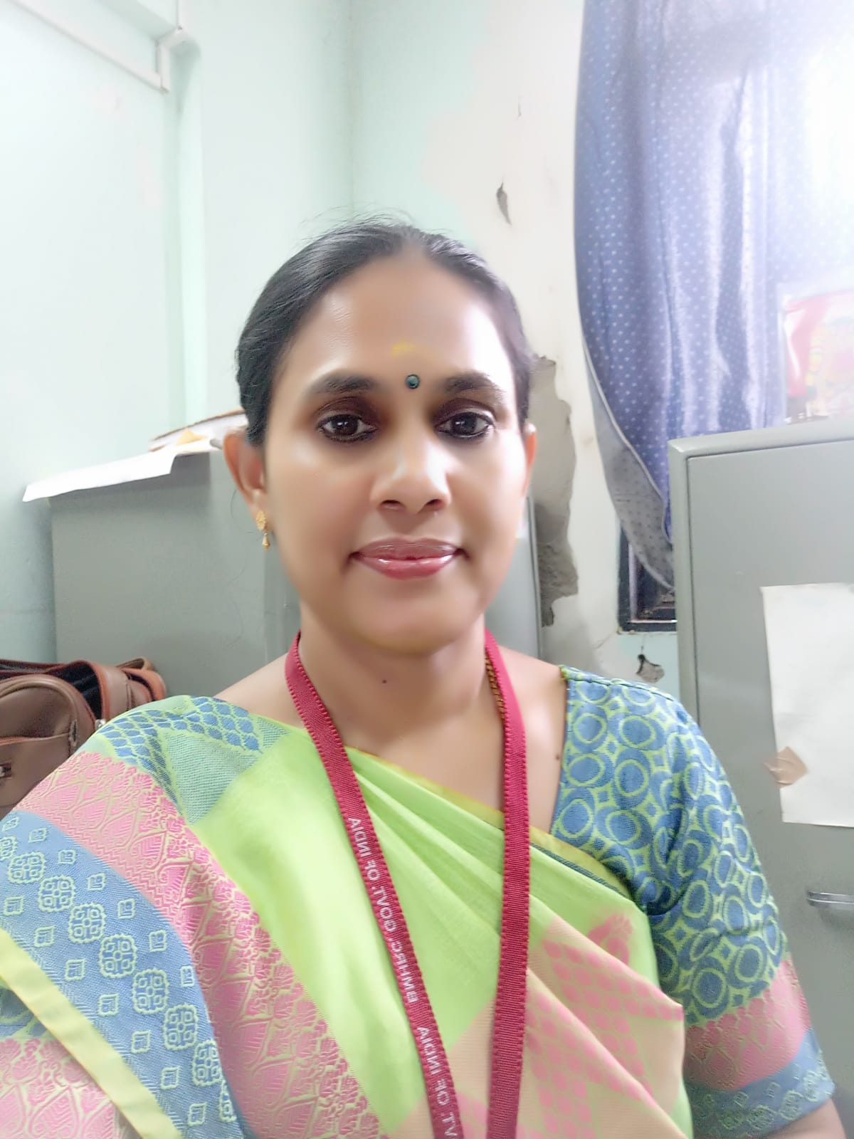
CURRICULUM VITAE
Dr. Radha.K Vice-Principal
Bhopal Nursing College,
Bhopal Memorial Hospital and Research Centre, (Under ICMR. MOH&FW, Govt of India),
Bhopal,MP State.
QUALIFICATION | YEAR | COLLEGE | UNIVERSITY
PH.D(N) | 2009- | INC consortium collaboration | Rajiv Gandhi
 | 2016 | with NIMHANS | University,
 |  |  | Karnataka
M.PHIL (N) | 2006- | Manipal college of Nursing • | Manipal University,
 | 2008 | MAHE, Manloal | Manioal, Karnataka
M.Sc(N) | 2004- | Adhiparasakthi College of | The Tamil Nadu
 | 2006 | Nursing, Melmaruvathur, | Dr. M.G.R Medical
 |  | kancheepuram | University
 |  |  | Chennai
M.SC | 2000- | Madras University | Madras University,
(PSYCHOLOGY) | 2002 |  | Chennai
B.SC(N) | 1995- | Padmavathi College of | The Tamil Nadu
 | 1999 | Nursing,Dharmapurl | Dr. M.G.R Medical
 |  |  | University
 |  |  | Chennai

Slide 44
Total year of Teaching experiences - 20 years
PadmavathiSchool of Nursing,Dharmapuri.TN - as a clinical instructor (1999- 2001)
PPG college of nursing ,Coimbatore - A ssst lecturer ( 2001-2004)
Sara college of nursing ,Dharapuram - Lecturer ( 2006-2009)
Adhiparasakthicollege of Nursing - Reader ( 2009-10)
Tamil Nadu State AIDS control society - Assistant Director in Nursing ( 201O· 2012)
L
Omsakthi college of Nursing ,Dharmapuri - Principal ( 2012- may 2013)
Bhopal Nursing College of Nursing .ICMR-BMHRC,Bhopal,M Pstate - Vice
-Principal ( since June 2013 -till date )
PUBLICATIONS:more than 20 articles published in National and International journals.

Slide 45
LIFE MEMBER
Trained Nurses Association of India
Nursing 1research society of India
Worki ng as a National Edi torial Member - More 10 jo urnals
1. Indian Journal of Surgical Nursing,
International journal of Practical Nursing
Indian journa lof communicable disease
Indian Journal of Medical and Health sciences
International journal of comprehensive Nursing
International journal of Humanities and social sciences studies
International of Psychiatric Nursing
International journal of review and research
Global journal of forensic studies
10.Editoria l Member(Associate Editor) of the journa l 'International Journal of Advances in Nursing Management'.

Slide 46
GUIDE and EXAM INER : UG and PG nursing students
Adjudicator/ Evaluator I Examiner
Ph.D (N) - Adjudicator in Meenakshi Academy of Higher Education and Research
-2018, Tamil Nadu, Sri Ramachndra institute ,Porur, Chennai , MGM institute , New Bombay ,chettinad university, Chennai, The TN Dr MGR Medical University, Chennai.

Slide 47
PLENARY SESSION - 4

Slide 48
POST TEST

Slide 49
CERTIFICATE DISTRIBUTION

